Slide 1
A Review of Artificial Intelligence's Neural Networks (Deep Learning) Applications in Medical Diagnosis and Prediction
2023/04/21
information source : ieee

Slide 2
CONTENT
BACKGROUND&INTRODUCTION
DEEP LEARNING APPROACHES IN
MEDICAL DIAGNOSIS
CHALLENGES AND STRENGTHS
IMPLEMENT WITH WEKA
CONCLUSION & FUTURE WORK

Slide 3
BACKGROUND AND INTRODUCTION

Slide 4
BACKGROUND
When doctors and researchers diagnose or analyze illnesses, they usually rely on detailed information about specific tissues and organs to make the optimal treatment plan.
Medical imaging has become a necessary part of diagnosis, prediction, and treatment processes.
MRI, PET, CT
Edge detection, textual features, morphological filtering, shape model building, and template matching.

Slide 5
INTRODUCTION
Machine learning models are trained with a massive amount of data and ultimately result in more accurate classification or prediction.
Increased capacity of computing power, wider range of data, and better models and algorithms.
The success of deep learning in computer vision has inspired many researchers to apply it to medical image analysis.
Review deep learning’s application in medical diagnosis and prediction.

Slide 6
DEEP LEARNING APPROACHES IN MEDICAL DIAGNOSIS

Slide 7
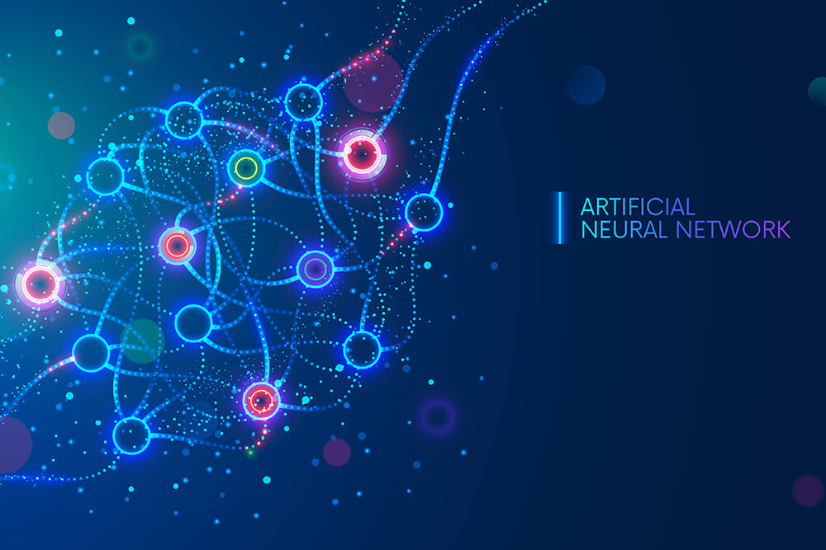
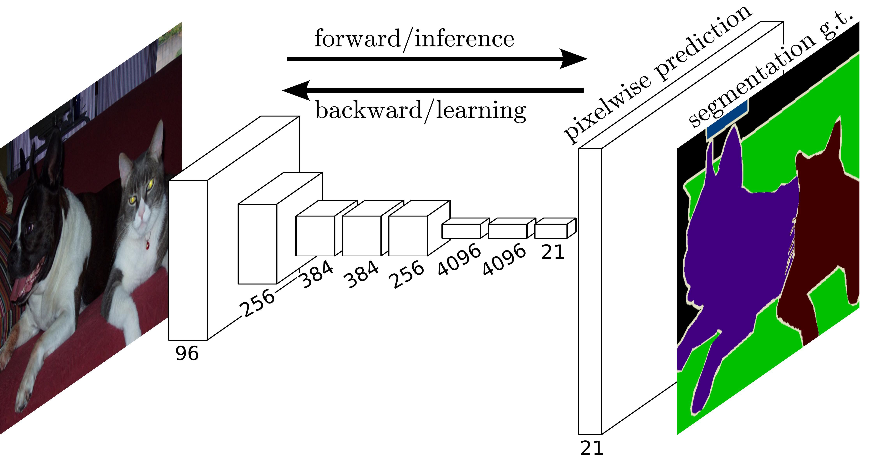

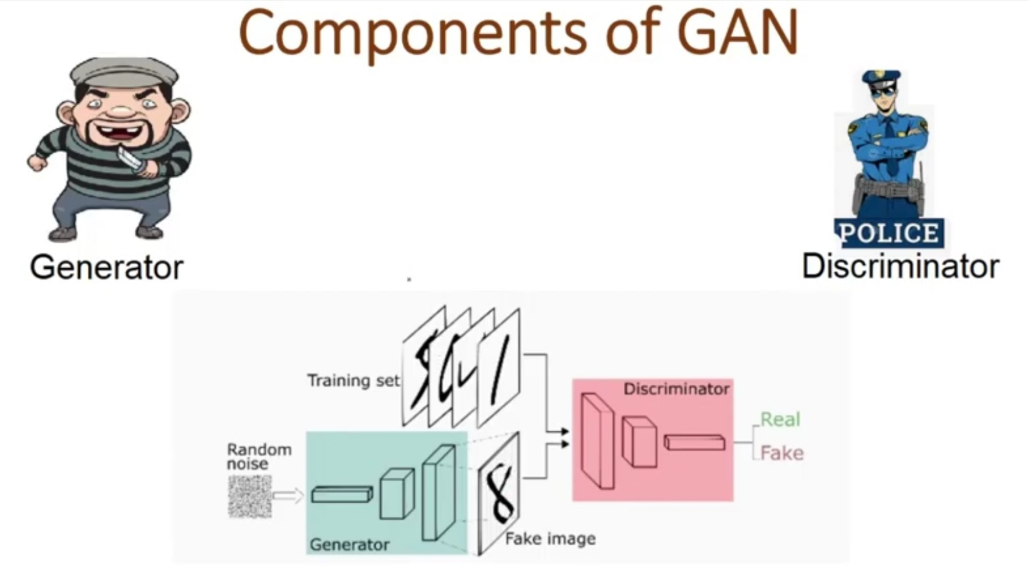
DEEP LEARNING APPROACHES IN MEDICAL DIAGNOSIS
ANN
FCN
CNN
GAN

Slide 8
Artificial Neural Networks(ANN)
Artificial neural networks (ANNs) is a subset of machine learning and are at the heart of deep learning algorithms.
Neural networks rely on training data to learn and improve their accuracy over time.
However, once these learning algorithms are fine-tuned for accuracy, they are powerful tools in computer science and artificial intelligence, allowing us to classify and cluster data at a high velocity.

Slide 9
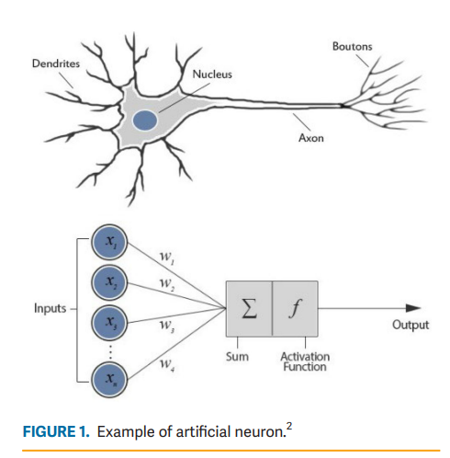
Artificial Neural Networks(ANN)
Three parts: input, activation function, and output.

Slide 10
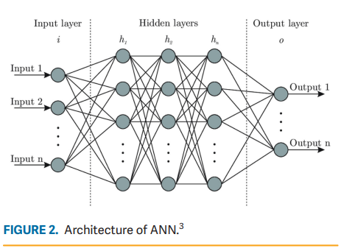
Artificial Neural Networks(ANN)
Three parts: input layer, one or more hidden layers, and an output layer.

Slide 11
Convolutional Neural Networks(CNNs)
In deep learning, a convolutional neural network (CNN/ConvNet) is a class of deep neural networks, most commonly applied to analyze visual imagery.
It uses a special technique called Convolution. Now in mathematics convolution is a mathematical operation on two functions that produces a third function that expresses how the shape of one is modified by the other.
https://www.analyticsvidhya.com/blog/2021/05/convolutional-neural-networks-cnn/

Slide 12
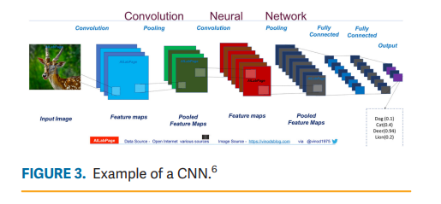
Convolutional Neural Networks(CNNs)
The structure of a CNN contains one input layer, one output layer, and multiple hidden layers.
The hidden layers include convolutional layers, pooling layers, and fully connected layers.

Slide 13
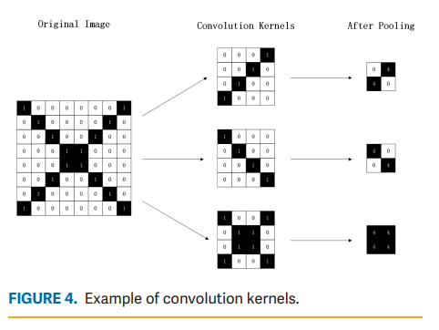
Convolutional Neural Networks(CNNs)
The key element of a convolutional layer is the convolution kernels.

Slide 14

Convolutional Neural Networks(CNNs)

Slide 15
Fully Convolutional Networks (FCNs)
The main idea of ​​FCN is to replace the fully connected layer with a convolutional layer, and an image of any size can be input, and the output will get a dense prediction of the category to which each pixel belongs, so that it can be applied to the Semantic Segmentation task, and at the same time realize end-to-end training.

Slide 16
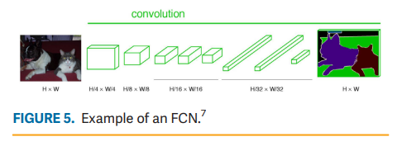
Fully Convolutional Networks (FCNs)
FCN replaces the fully connected layers with convolutional layers.
The last step in FCN is to unsample the heatmap through deconvolution layers.

Slide 17
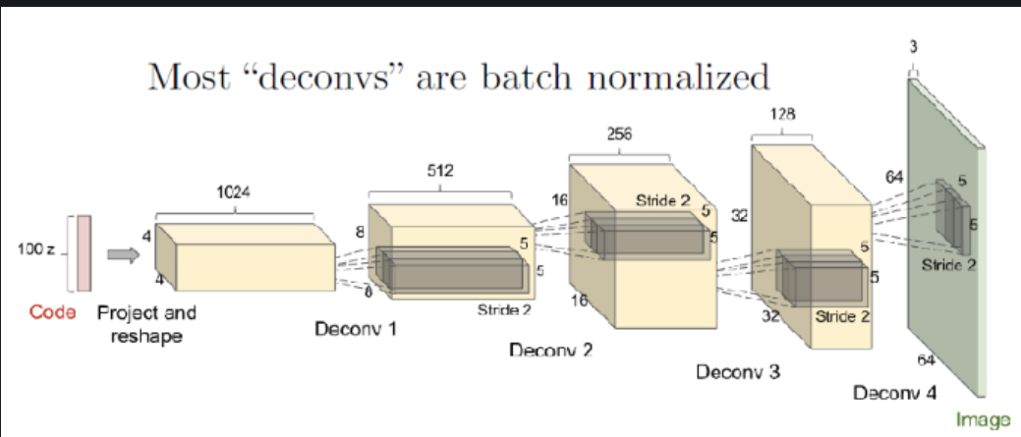
Fully Convolutional Networks (FCNs)

Slide 18
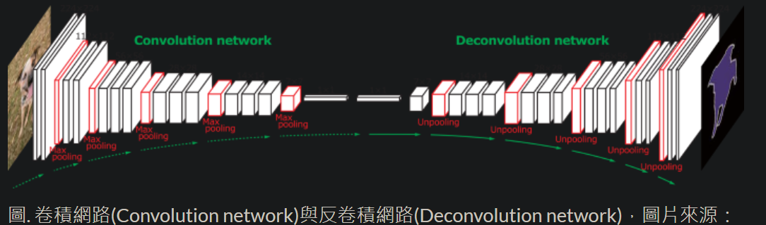
Fully Convolutional Networks (FCNs)

Slide 19
Generative Adversarial Networks (GANs)
GANs are a clever way of training a generative model by framing the problem as a supervised learning problem with two sub-models: the generator model that we train to generate new examples, and the discriminator model that tries to classify examples as either real (from the domain) or fake (generated).

Slide 20
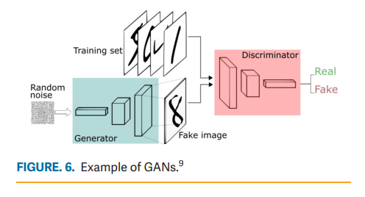
Generative Adversarial Networks (GANs)
Two neural networks
(1) generative network
(2) discriminative network

Slide 21
IMPLEMENT WITH WEKA

Slide 22
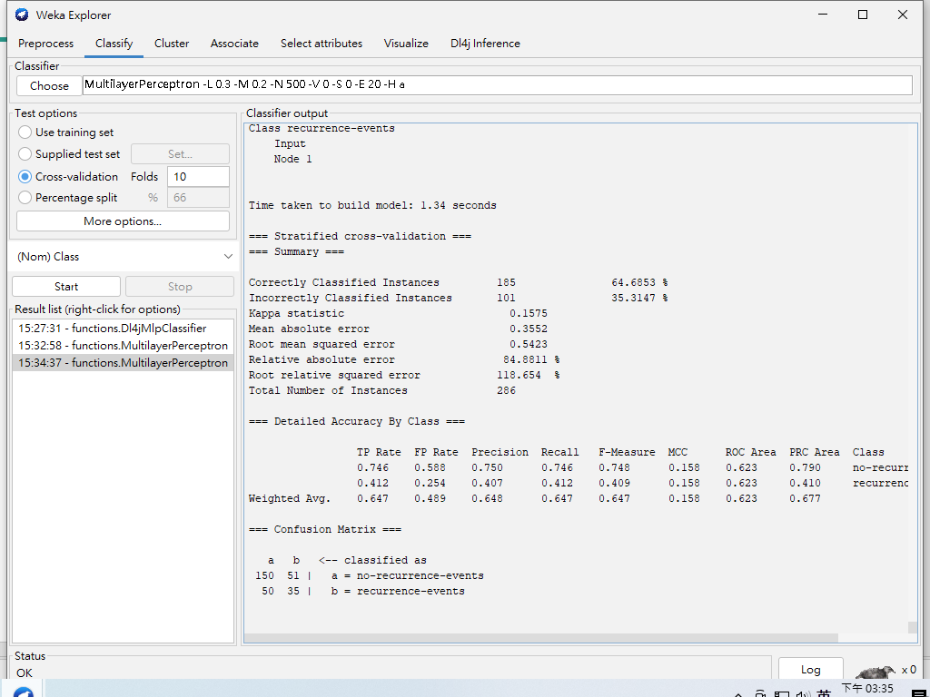
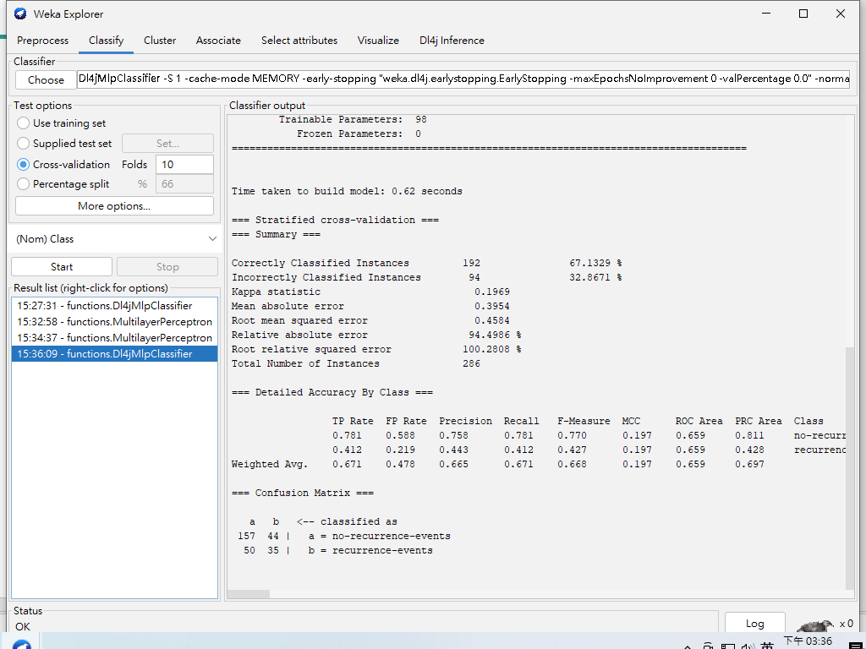
ANNs v.s CNNs

Slide 23
CHALLENGES AND STRENGTHS

Slide 24
CHALLENGES
Although CNN has a promising capability in image classification and pattern recognition, it has limited capability in segmentations.
FCN has limitations in fixed receptive size.
Overfitting happens when data are limited and a model captures the patterns and regularities.
Deep learning is computationally expensive.

Slide 25
STRENGTHS
The performance of deep learning significantly surpasses other learning algorithms after the amount of data reaches a certain level.
The neural networks generally have high fault tolerance.
Missing data or data corruption does not affect the results.

Slide 26
FUTURE OUTLOOK

Slide 27
FUTURE OUTLOOK
Data digitization and standardization provide a solution to inconsistent size and image positions.
The development of graphics processing unit (GPUs) has significantly increased the computing power.
Cloud computing has also incited many discussions within the healthcare industry.
Nonetheless, moving on to the cloud also raises concerns for data privacy and security.
Deep learning application in medical diagnosis and prediction shows promising results.

Slide 29
References
WekaDeeplearning4j : https://deeplearning.cms.waikato.ac.nz/examples/train_cnn/#training-a-cnn
FCN: https://medium.com/ching-i/fully-convolutional-networks-%E8%AB%96%E6%96%87%E9%96%B1%E8%AE%80-246aa68ce4ad
GAN: https://machinelearningmastery.com/what-are-generative-adversarial-networks-gans/

